Slide 1
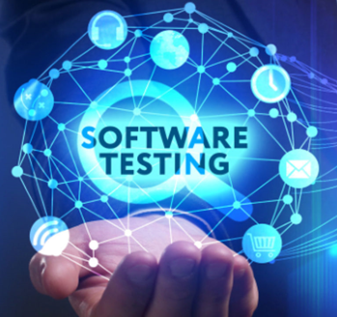
Software Testing
By
Dr. Junaid Akram
Assistant Professor at Department of
Computer Science, Comsats (Lahore)

Slide 2
What is Software Testing
Software testing is an investigation conducted to provide stakeholders with information about the quality of the software under test.
It meets the requirements that guided its design and development
It responds correctly to all kinds of inputs
It performs its functions within an acceptable time
It can be installed and run in its intended environments
It achieves the general result that stakeholders desire
It is free from errors, flaws, vulnerabilities, or any other security issues
Software testing is used in association with verification and validation
Verification: Have we built the software right? (i.e., does it implement the requirements)
Validation: Have we built the right software? (i.e., do the deliverables satisfy the customer)

Slide 3
Why Do We Test Software?
Software Testing Saves Money
In year 2014, the bit-coin exchange filed for bankrupt after 460 million dollars was stolen by hackers due to weakness in the system.
Security ( the most sensitive and yet most vulnerable part )
In September 2012, IEEE was exposed by its user names and plain text passwords for almost 100,000 of its members.
China Airlines Airbus A300 crashed due to a software bug on April 26, 1994, killing 264 innocent lives.
The user gets a trustworthy product
Keeps user’s personal information and data safe
Vulnerability free products
A tester’s goal is to eliminate faults as early as possible

Slide 4
Why Do We Test Software?
Product Quality
In order to make your product vision come to life, it has to work as planned
Product should work properly to ensure great customer experience
Device compatibility should be checked on different products
Customer Satisfaction
British Airways –a major IT software failure led to massive cancellations on local flights and significant delays on international flights.
The ultimate goal for a product owner is to give the best customer satisfaction.
All could be eliminated if you invest in testing at the start product development.
Faults in software are equivalent to design mistakes in hardware

Slide 5
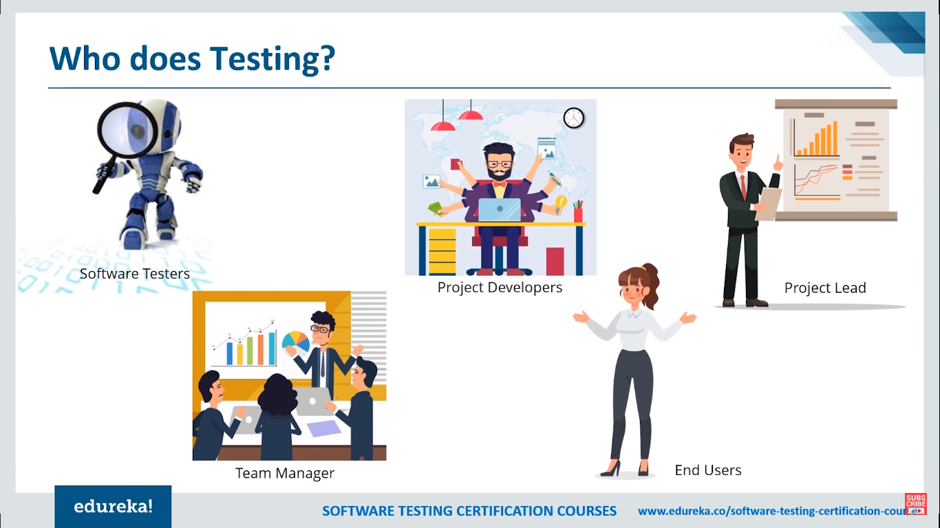
Who Does Testing

Slide 6
Do I Need to Do Testing?
Everyone who develops software does testing—that’s unavoidable
Why it matters? —The goal is to try as many “critical” input combinations as possible, given the time and resource constraints
i.e., to achieve as high coverage of the input space as is practical, while testing first the “highest-priority” combinations
Key issue: strategies for identifying the “highest priority” tests

Slide 7
Overview of Software Testing
“Testing shows the presence, not the absence of bugs”
A fault, also called “defect” or “bug,” is an erroneous hardware or software element of a system that can cause the system to fail
Test-Driven Development (TDD)
Every step in the development process must start with a plan of how to verify that the result meets a goal
A test case is a particular choice of input data to be used in testing a program and the expected output or behavior
A test is a finite collection of test cases
White-box testing exploits structure within the program (assumes program code available)
Black-box testing explores input space of functionality defined by an interface specification

Slide 8
Why Testing is Hard
Any nontrivial system cannot be completely tested
Our goal is to find faults as cheaply and quickly as possible.
Ideally, we would design a single “right” test case to expose each fault and run it
In practice, we have to run many “unsuccessful” test cases that do not expose any faults
Time Consuming

Slide 9
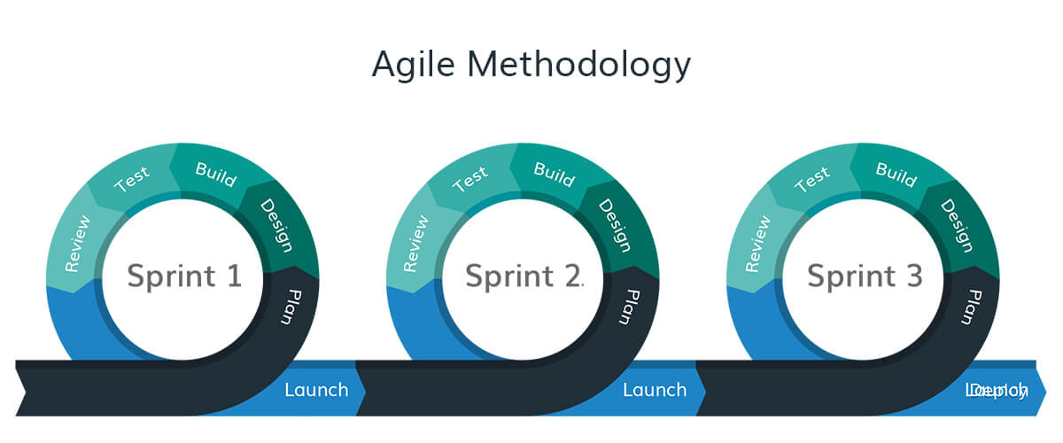
Testing in the 21st Century
Today’s software market :
is much bigger , is more competitive, has more users
Embedded Control Applications
airplanes, air traffic control
spaceships
watches
Agile processes increased pressure on testers
Tests are key to functional requirements
Industry is going through a revolution in what testing means to the success of software products
memory seats
DVD players
garage door openers
ovens
remote controllers
cell phones & PDAs

Slide 10
Need to Test
Vulnerabilities always exist….
Because the software often rushed to the market….
And it was developed by people….
And people do make mistakes….
Which allow attackers to attack and compromise the systems….
All an attacker need is a small weakness or a flaw in your system to exploit

Slide 11
Testing Approach Static, Dynamic and Passive Testing
Reviews, walkthroughs, proofreads, inspections, check source code structure or compilers check syntax are referred as static testing
Executing programmed code with a given set of test cases is referred to as dynamic testing.
Static testing involves verification, whereas dynamic testing involves validation
Passive testing means verifying the system behaviour by looking at system logs and traces.
This is related to offline runtime verification and log analysis.

Slide 12

What Types of Testing Are There?
Functional Testing types include:
Unit Testing
Integration Testing
System Testing
Smoke Testing
Interface Testing
Regression Testing
Beta/Acceptance Testing
Non-Functional Testing types include:
Performance Testing
Load Testing
Volume Testing
Security Testing
Compatibility Testing
Installation Testing
Recovery Testing
Reliability Testing
Usability Testing
Which Testing type has more importance and why ?
40 Testing Types are mentioned here
https://www.softwaretestinghelp.com/types-of-software-testing/

Slide 13
One possible classification is based on the following four classifiers:
C1: Source of test generation.
C2: Lifecycle phase in which testing takes place
C3: Goal of a specific testing activity
C4: Characteristics of the artifact under test

Slide 14
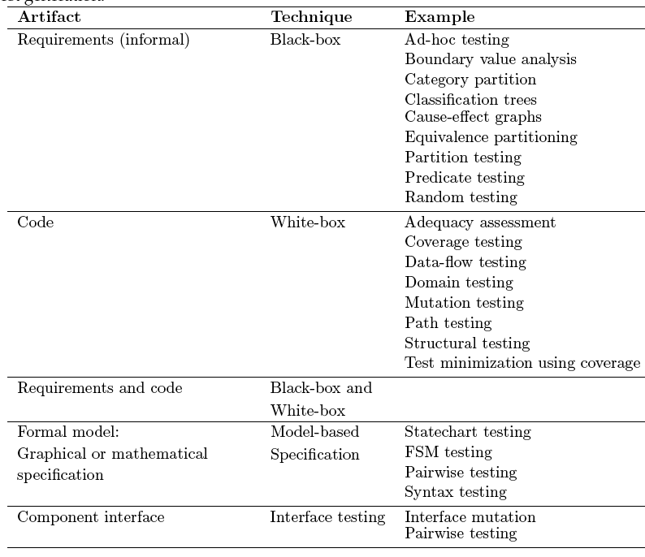
C1: Source of test generation

Slide 15
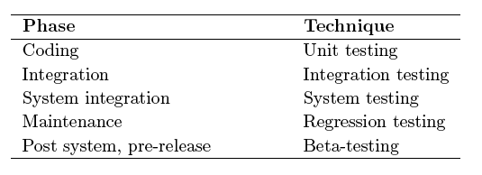
C2: Lifecycle phase in which testing takes place

Slide 16
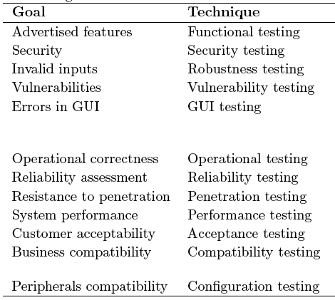
C3: Goal of specific testing activity

Slide 17
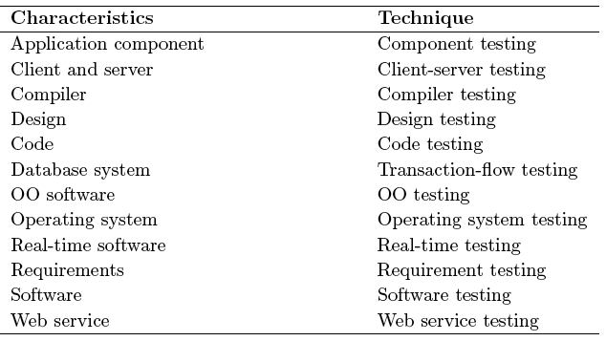
C4: Artifacts under test

Slide 18
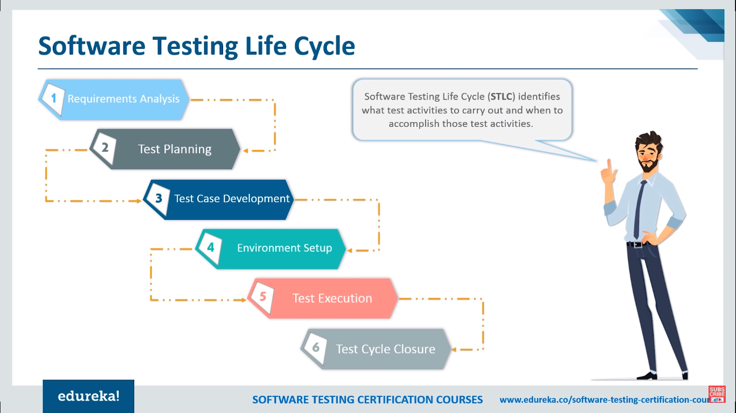
A Sample Testing Cycle
Although variations exist between organizations, there is a typical cycle for testing

Slide 19
A Sample Testing Cycle
Requirements analysis: Testing should begin in the requirements phase of the software development life cycle. During the design phase, testers work to determine what aspects of a design are testable.
Test planning: Test strategy, test plan, test creation.
Test development: Test procedures, test scenarios, test cases, test datasets, test scripts to use in testing software.
Test execution: Testers execute the software based on the plans and test documents then report any errors found to the development team.
Test reporting: Once testing is completed, testers generate metrics and make final reports.
Test result analysis: It is done by the development team usually along with the client, in order to decide what defects should be fixed or deferred to be dealt with later.
Defect Retesting: Once a defect has been dealt with, it is retested by the testing team.
Regression testing: It is common to have a small test program built of a subset of tests, for each integration of new, modified, or fixed software, in order to ensure that the latest delivery has not ruined anything and that the software product as a whole is still working correctly.
Test Closure: Once the test meets the exit criteria, the activities such as capturing the key outputs, lessons learned, results, logs, documents are archived.

Slide 20
Logical Organization of Testing
( Usually not done in a linear step-by-step order and completed when the last step is reached! )
Component (unit) code
Unit test
White box testing
(by developer)
Black box testing
(by customer)
Tested component
Component (unit) code
Unit test
Integration test
Integrated modules
System test
System in use
Ensures that all components work together
Component (unit) code
Unit test
Function test
Quality test
Acceptance test
Installation test
Ensure that each component works as specified
Verifies that functional requirements are satisfied
Verifies non-functional requirements
Customer verifies all requirements
Testing in user environment (“platform”)

Slide 21
Example: Test Case for Use Case
Test-case Identifier: | TC-1
Use Case Tested: | UC-1, main success scenario, and UC-7
Pass/fail Criteria: | The test passes if the user enters a key that is contained in the database, with less than a maximum allowed number of unsuccessful attempts
Input Data: | Numeric keycode, door identifier
Test Procedure: |  | Expected Result:
Step 1. Type in an incorrect keycode and a valid door identifier |  | System beeps to indicate failure; records unsuccessful attempt in the database; prompts the user to try again
Step 2. Type in the correct keycode and door identifier |  | System flashes a green light to indicate success; records successful access in the database; disarms the lock device
21

Slide 22
Test Coverage
Test coverage measures the degree to which the specification or code of a software program has been exercised by tests
“Big picture”: Specification testing focuses on the coverage of the input space, without necessarily testing each part of the software ⬅ Acceptance tests
“Implementation details”: Code coverage measures the degree to which the elements of the program source code have been tested ⬅ Unit tests

Slide 23
Integration Testing
Key Issue:
How to assemble individually-tested “units” and quickly locate faults that surface during integration
Horizontal Integration Testing
Bottom-up integration
Top-down integration
Vertical Integration Testing
Vertically slice the system by use cases and first integrate within each slice (using any of the horizontal integration techniques)

Slide 24
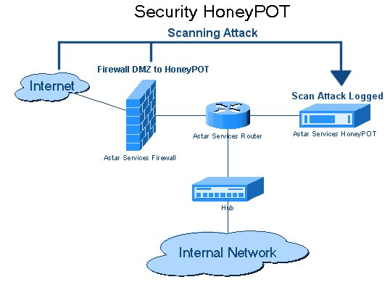
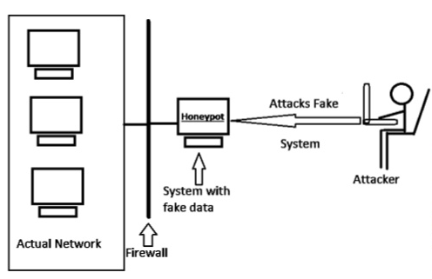
Security Honeypots
A deception used to detect and study network attacks
Part of security testing of software systems
Notes:
https://en.wikipedia.org/wiki/Honeypot_(computing) https://www.sans.edu/cyber-research/security-laboratory/article/honeypots-guide

Slide 25

Thanks for your attention!
Any Question?

